Slide 1






Latent Semantic Analysis SVD
Royal University of Phnom Penh
Dr. VENG Sotheara

Slide 2
Group Members
Hor Kimhouy
Huot Rithy
Sue Sreyneth
Heng Phanith
Pov Mannkorng
Tie Keanghao

Slide 3
Welcome !
Today's Agenda
Introduction
Dataset
Latent Semantic Analysis (LSA)
Text Representation (TF-IDF)
Core Method: SVD (Singular Value Decomposition)
Search Method: Cosine Similarity
Results and Analysis
Limitations

Slide 4

1. INTRODUCTION
ROYAL UNIVERSITY OF PHNOM PENH
SVD-Based Movie Search Engine
Traditional keyword search fails when a query uses different words than a document — even if it means the same thing. Latent Semantic Analysis (LSA) solves this by discovering hidden topics in a corpus and matching by topic, not exact term.

Slide 5
1. INTRODUCTION
ROYAL UNIVERSITY OF PHNOM PENH
Our Problem
Our Solution
Query: "specter haunting mansion"
Document: "A ghost keeps returning to the old house"
Keyword match: 0 matches (different words)
LSA match: high similarity (same latent horror topic)
Corpus: CoreNLP POS-filtered lemmas
Vectorize: TF-IDF
Reduce: Truncated SVD (k=150k=150)
Retrieve: Cosine similarity in latent space

Slide 6

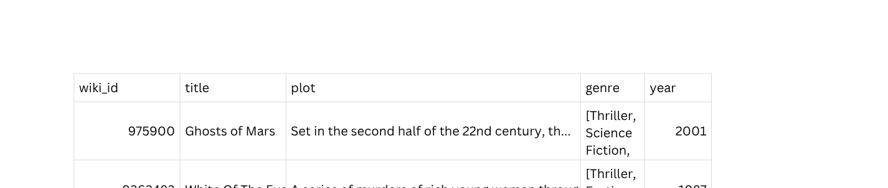
2. DATASET
ROYAL UNIVERSITY OF PHNOM PENH
Source
CMU MovieSummaries (42 k movies joined from metadata + plot summaries) annotated with **Stanford CoreNLP** — the largest freely available lemmatized movie corpus.
Reference: http://www.cs.cmu.edu/~ark/personas/
Dataset
Schema
This Dataset contains key information including but not limit too:
wiki_id, title, plot, genre, year
Preview

Slide 7
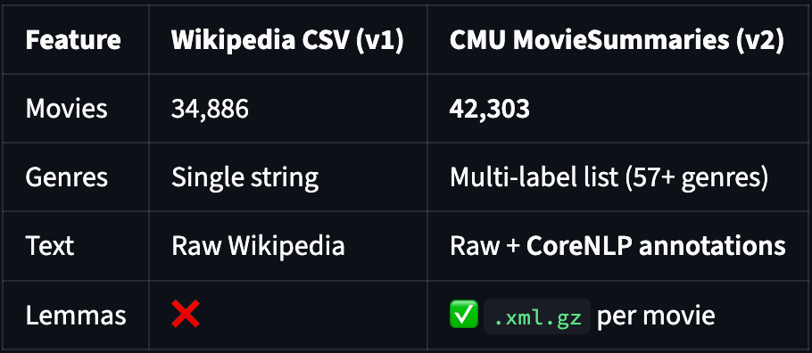

2. DATASET
ROYAL UNIVERSITY OF PHNOM PENH
Why this Dataset ?

Slide 8
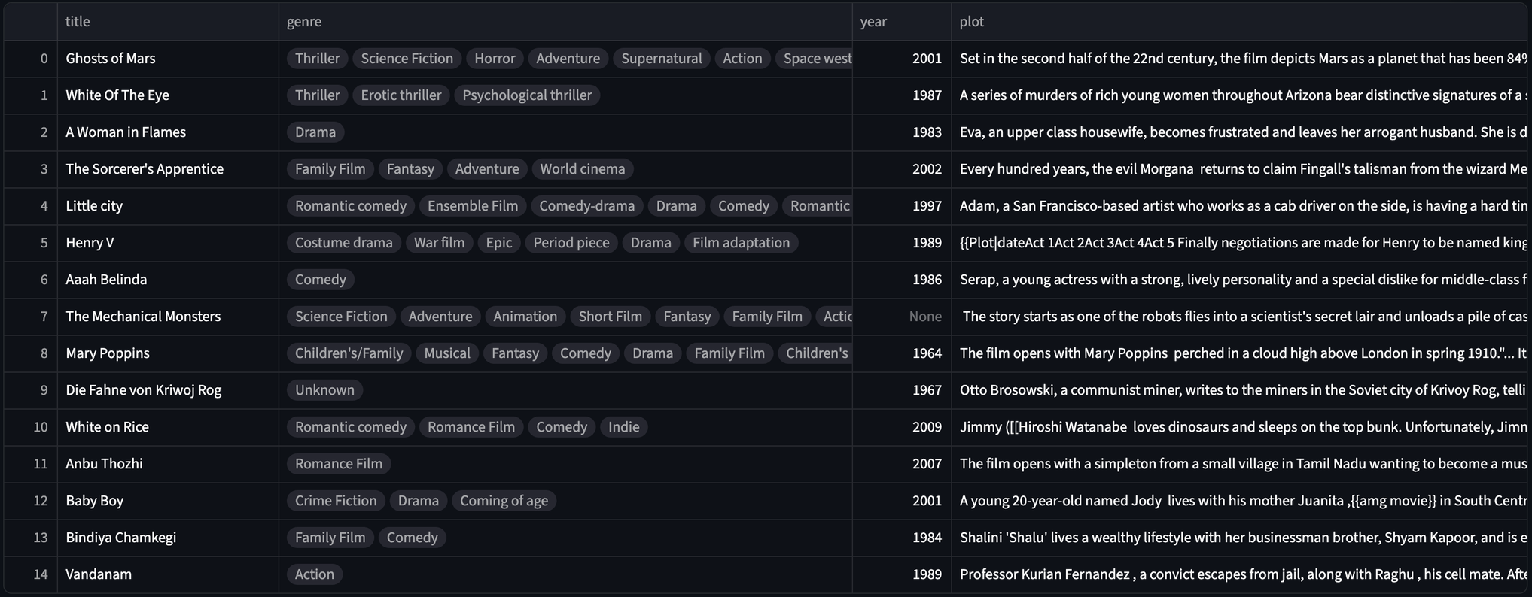
2. DATASET
ROYAL UNIVERSITY OF PHNOM PENH

Slide 9
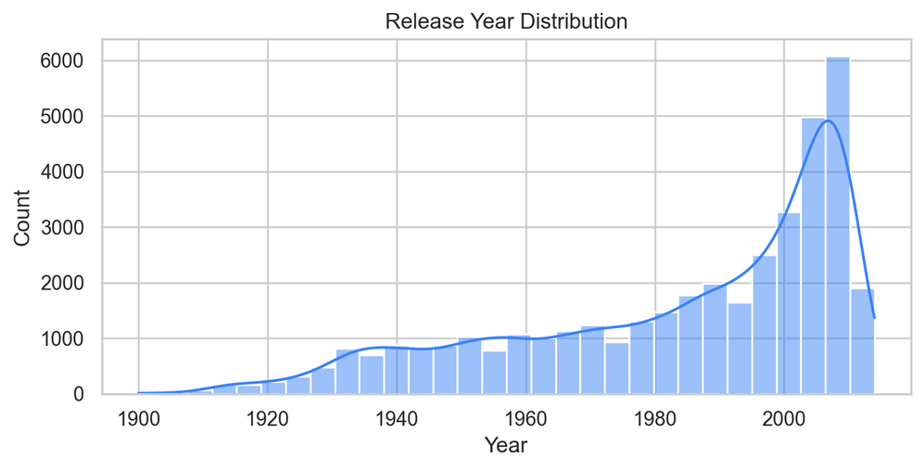
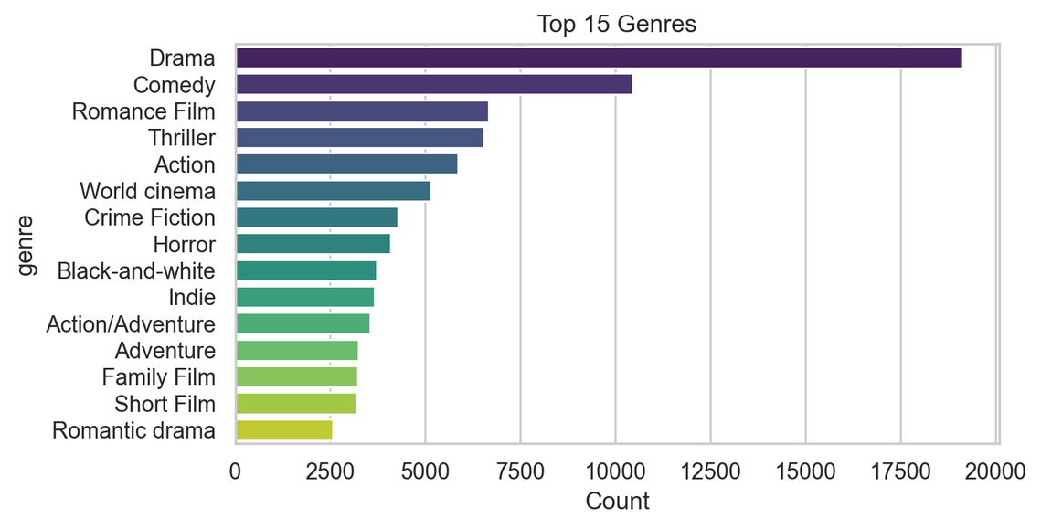
2. DATASET
ROYAL UNIVERSITY OF PHNOM PENH

Slide 10
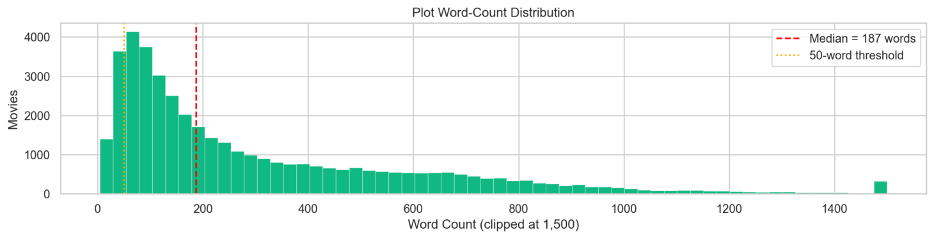
2. DATASET
ROYAL UNIVERSITY OF PHNOM PENH

Slide 11

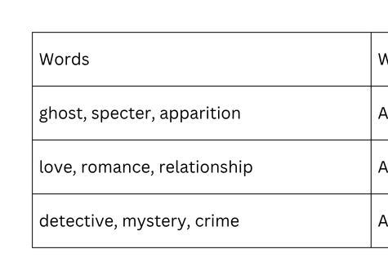
3. LATENT SEMANTIC ANALYSIS (LSA)
ROYAL UNIVERSITY OF PHNOM PENH
The Core Idea
Words that appear in similar documents tend to have similar meanings — even if they are spelled differently.
LSA learns these relationships automatically from co-occurrence patterns, with no hand-crafted rules or dictionaries.

Slide 12
3. LATENT SEMANTIC ANALYSIS (LSA)
ROYAL UNIVERSITY OF PHNOM PENH
Key Capability: Vocabulary Mismatch
Query: "specter haunting mansion"
Document: "ghost returns to old house"
Keyword search: 0 matching words → no result
LSA: both query and document project onto the same horror latent dimension → high cosine similarity → correct match
This is the fundamental advantage of LSA over keyword search.

Slide 13
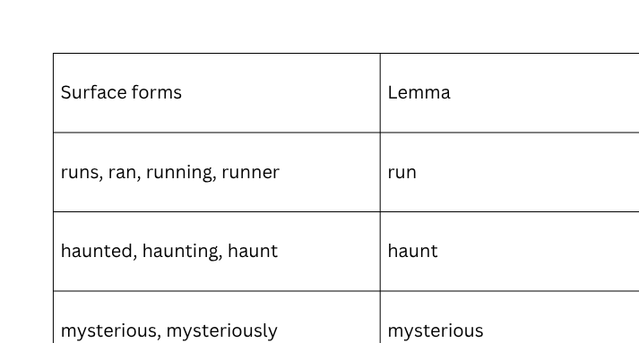
3. LATENT SEMANTIC ANALYSIS (LSA)
ROYAL UNIVERSITY OF PHNOM PENH
What is a Lemmatized Corpus?
Before feeding text to LSA, we lemmatize it — reducing each word to its canonical base form:

Slide 14
3. LATENT SEMANTIC ANALYSIS (LSA)
ROYAL UNIVERSITY OF PHNOM PENH
What is a Lemmatized Corpus?
We also POS-filter — keeping only nouns, verbs, and adjectives. Prepositions, articles, and conjunctions appear in every document and provide no discriminating signal.
KEEP: CONTENT WORDS:
DISCARD (FUNCTION WORDS):
NN, NNS, NNP, NNPS → NOUNS
VB, VBD, VBG... → VERBS
JJ, JJR, JJS → ADJECTIVES
DT → THE, A, AN
IN → IN, ON, AT, OF
CC → AND, OR, BUT
PRP → HE, SHE, THEY

Slide 15

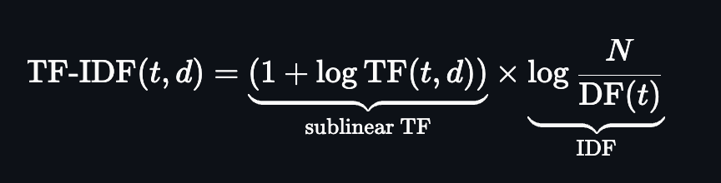
4. TEXT REPRESENTATION (TF-IDF)
ROYAL UNIVERSITY OF PHNOM PENH
What is TF-IDF?
TF — how often term tt appears in document dd (sublinear to dampen repetition)
IDF — how rare tt is across all NN documents (rewards discriminating terms)
Result: each document becomes a sparse vector in VV-dimensional term space

Slide 16
4. TEXT REPRESENTATION (TF-IDF)
ROYAL UNIVERSITY OF PHNOM PENH
Matrix shape
Sparsity
Non-zeros
42,204 × 341,039
99.96%
6,470,623

Slide 17
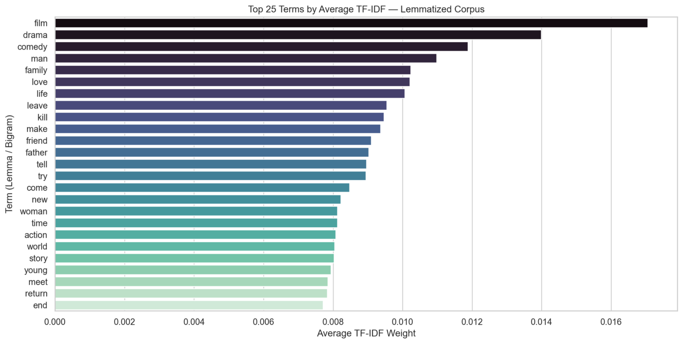
4. TEXT REPRESENTATION (TF-IDF)
ROYAL UNIVERSITY OF PHNOM PENH
Top 25 Terms by Average TF-IDF Weight

Slide 18
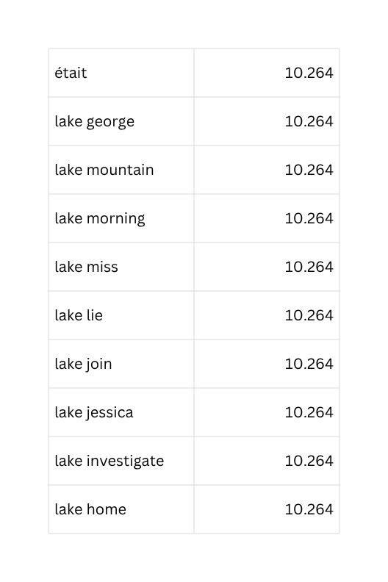
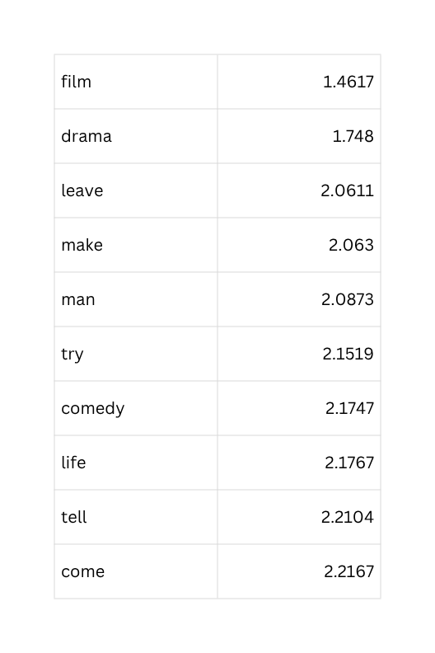
4. TEXT REPRESENTATION (TF-IDF)
ROYAL UNIVERSITY OF PHNOM PENH
IDF Extremes
MOST DISCRIMINATING (HIGHEST IDF)
LEAST DISCRIMINATING (LOWEST IDF)

Slide 19
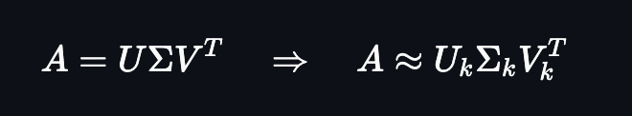
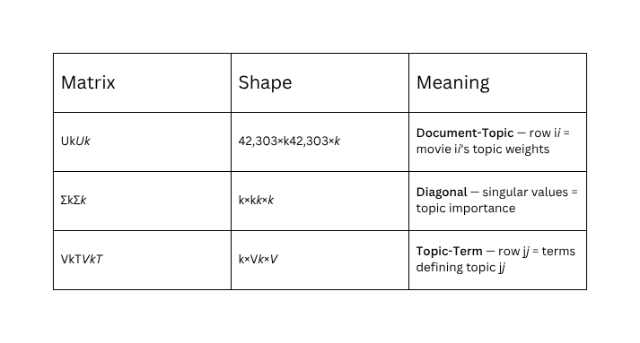
5. CORE METHOD: SINGULAR VALUE DECOMPOSITION (SVD)
ROYAL UNIVERSITY OF PHNOM PENH
The Three Matrices
Why Truncate?
THE FULL SVD CAPTURES EVERYTHING — INCLUDING NOISE.
LARGE SINGULAR VALUES → COHERENT TOPICS (HORROR, ROMANCE, ACTION)
SMALL SINGULAR VALUES → NOISE (RARE TERM COMBINATIONS, TYPOS)
TRUNCATING TO K=150K=150 REMOVES NOISE AND FORCES THE MODEL TO GENERALIZE ACROSS VOCABULARY VARIATION — THE CORE MECHANISM OF LSA.

Slide 20
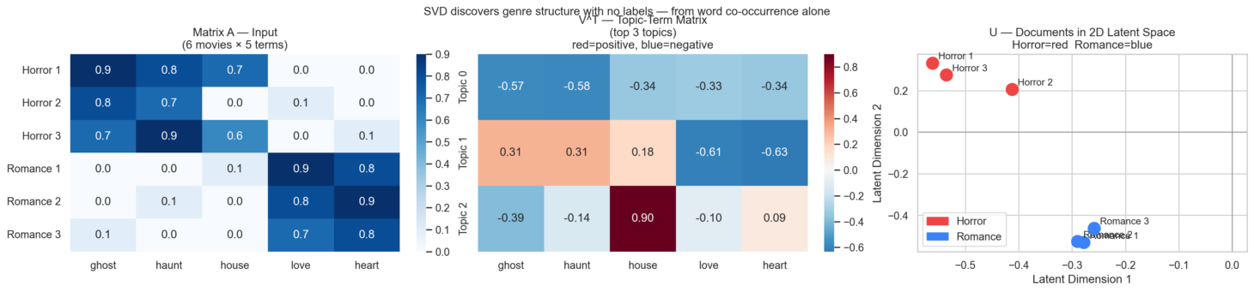
5. CORE METHOD: SINGULAR VALUE DECOMPOSITION (SVD)
ROYAL UNIVERSITY OF PHNOM PENH
Conceptual Example: 6 Movies × 5 Terms
A hand-crafted example showing SVD discovering genre structure automatically:

Slide 21
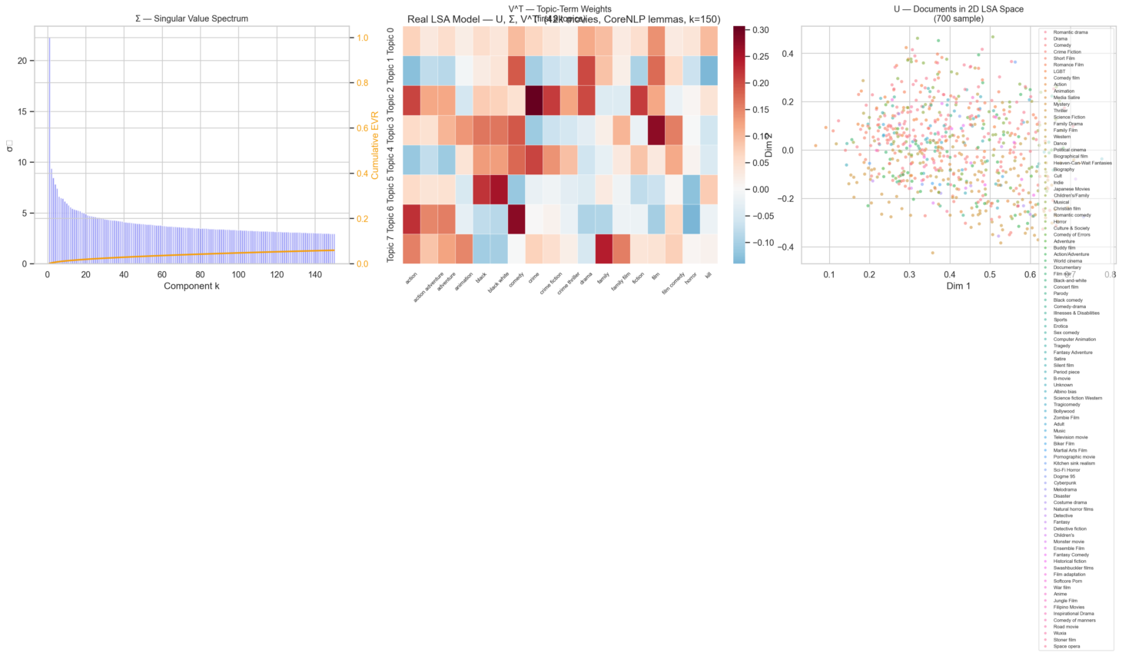
5. CORE METHOD: SINGULAR VALUE DECOMPOSITION (SVD)
ROYAL UNIVERSITY OF PHNOM PENH
Real Model — U, Σ, V^T

Slide 22
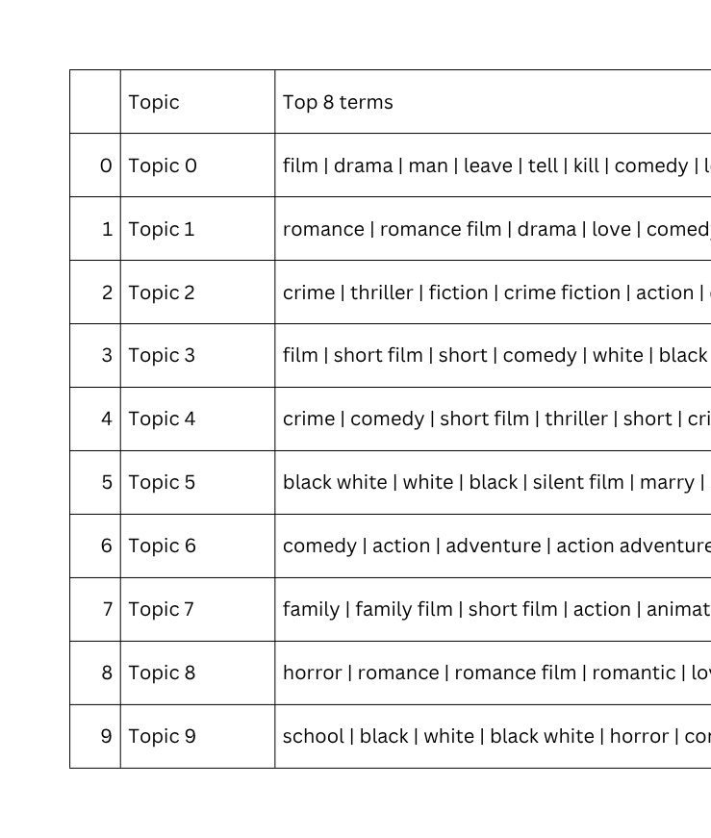
5. CORE METHOD: SINGULAR VALUE DECOMPOSITION (SVD)
ROYAL UNIVERSITY OF PHNOM PENH
Top Terms per Latent Topic
Each row of VTVT defines a topic. Here are the top words for the first 10:

Slide 23
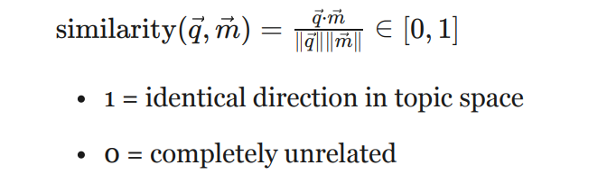
6. SEARCH METHOD: COSINE SIMILARITY
ROYAL UNIVERSITY OF PHNOM PENH
What is Cosine Similarity?
AFTER LSA PROJECTION, EVERY MOVIE AND EVERY QUERY IS A DENSE VECTOR IN K-DIMENSIONAL LATENT SPACE. WE MEASURE SIMILARITY USING THE COSINE OF THE ANGLE BETWEEN THEM:
Weighted score used in the app:
score = α ⋅ similarity + (1 − α) ⋅ rating (normalized)
Default α = 0.85 semantic match matters more, rating breaks ties.

Slide 24
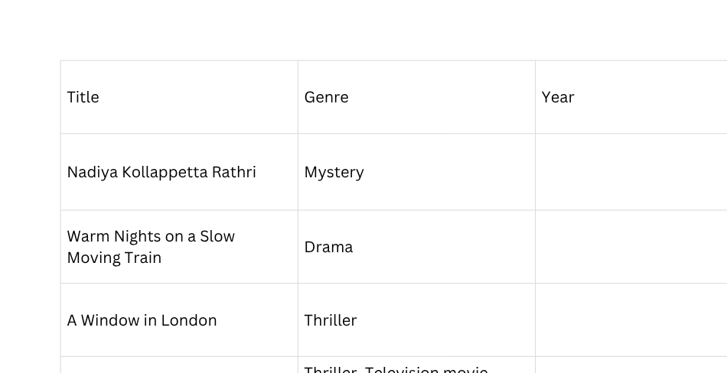
7. RESULTS AND ANALYSIS
ROYAL UNIVERSITY OF PHNOM PENH
Result & Analysis
Result explanation
Query:
“haunted house ghost supernatural”

Slide 25
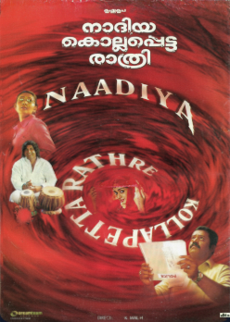
7. RESULTS AND ANALYSIS
ROYAL UNIVERSITY OF PHNOM PENH
Plot:
Internationally famous Indian sharp shooter Nadiya Mether, famous dancer Thulasimani, and television reporter Shreya Maria are all murdered in the same car on the Sauparnika Express between Chennai and Mangalore.
The other occupants in the car were: actress Priya Rose with her mother Rajamma and father; four doctors traveling together; Tamil Novelist Seetharaman; Palakkad Railway Police Superintendent Alexander Chempadan; Madhavan Master, his wife and their mentally unstable son Balu; the conductor; and the steward...
Nadiya Kollappetta Rathri

Slide 26

7. RESULTS AND ANALYSIS
ROYAL UNIVERSITY OF PHNOM PENH
Plot:
In 1934, famed Belgian detective Hercule Poirot solves a theft at the Church of the Holy Sepulchre in Jerusalem. Intending to return to London, his friend Bouc arranges accommodations for Poirot aboard the Simplon-route train, the Orient Express. Alongside Bouc, Poirot's fellow passengers include widow Caroline Hubbard; businessman Edward Ratchett, his manservant Edward Masterman and secretary Hector MacQueen; elderly Russian Princess Natalia Dragomiroff and her maid Hildegarde Schmidt; Hungarian diplomat Count Rudolf Andrenyi and his wife Elena...
Having received threatening letters, Ratchett attempts to hire Poirot to protect him during the journey, but Poirot declines, not wanting to do business with a suspicious character. An avalanche derails the train's engine, stranding the passengers until a rescue crew can re-rail the locomotive. During the night, Poirot is awakened by strange noises in the hall next to his cabin and sees someone in a red kimono rushing down the aisleway. Ratchett is found murdered the following morning, stabbed 12 times...
Murder on the Orient Express

Slide 27

8. LIMITATIONS
ROYAL UNIVERSITY OF PHNOM PENH
Technical Limitation
"Semantic Drift" Problem (Dimensionality Choice)
K too small
K too high
The model forces unrelated concepts together. It might decide that "Space" and "Submarines" are the same because they both involve "crews in a confined metal tube."
You lose the "latent" benefit. The model starts treating every unique word as its own dimension, essentially turning back into a basic keyword search that can't handle synonyms

Slide 28

8. LIMITATIONS
ROYAL UNIVERSITY OF PHNOM PENH
Technical Limitation
Context Blindness
Bag-of-words / no word order
Negation
LSA calculates the co-occurrence of terms but lack real semantic understanding.
Example:
"dog bites man" = "man bites dog" in TF-IDF
searching for "Not a horror movie" is would not work. LSA sees the high-weight word "Horror" and ignores the "Not," leading the user directly to the genre they wanted to avoid

Slide 29
8. LIMITATIONS
ROYAL UNIVERSITY OF PHNOM PENH
Technical Limitation
Static model
The model must retrain when new movies are added

Slide 30

8. LIMITATIONS
ROYAL UNIVERSITY OF PHNOM PENH
Data Limitation
Sparse Data & Feedback loop limitation
Short Plots
"Cold Start" & Missing Feedback Loop
In a TF-IDF matrix, a short plot might only have 2 or 3 non-zero values. Upon compression via SVD, the movie becomes a "ghost" in the vector space - it has no strong identity
Most modern search engines can actively from User action. However, since LSA is offline and expensive to train, it cannot learn in realtime

Slide 31
GROUP 5
ROYAL UNIVERSITY OF PHNOM PENH
Potential Steps
BM25 over TF-IDF
SBERT Mode: True Semantic Understanding
BM25 (Best Matching 25) uses "saturation." Once a word like "murder" appears 3 or 4 times in a plot, BM25 stops giving it extra points.
This can prevents long, repetitive Wikipedia summaries from unfairly dominating the search results just because they mention a keyword more often
Instead of looking at a "bag of words" as LSA; SBERT uses a Transformer architecture to create a single vector for the entire sentence.
It understands that "A man chasing a dog" and "A dog chasing a man" are different & also handles negation "not a comedy"

Slide 32
GROUP 5
ROYAL UNIVERSITY OF PHNOM PENH
Thank you
For Your Time!

